Slide 1
ML Final
Michael Strohmeier

Slide 2
Motivation
NBA salaries are a function of player performance, market trends, and negotiation. Understanding these drivers can help teams, agents, and players make better decisions.

Slide 3
Literature Review
The Kaggle project titled "NBA Salary Predictor - Data Science Final 2024" by Dillon Timmer focuses on predicting NBA player salaries using machine learning techniques.
Feature Importance: Certain player statistics, such as points per game, assists, and player efficiency ratings, were found to be significant predictors of salary.
Model Performance: Among the models tested, ensemble methods like Random Forest and Gradient Boosting provided better predictive accuracy compared to simple linear regression.

Slide 4
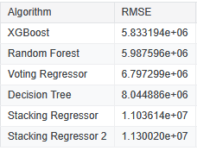
Literature Review
The project demonstrated that machine learning models could effectively predict NBA player salaries based on performance statistics. The insights gained could be valuable for teams and analysts in assessing player value and making informed contract decisions.

Slide 5
Data Overview
10,932 player-seasons (rows)
Key Features:
Player Overview
Player
Season
Team
Position
Age
Salary Info:
Salary (raw)
Inflation Adjusted Salary (target)
Shooting:
FG, FGA, FG%
3P, 3PA, 3P%
2P, 2PA, 2P%
FT, FTA, FT%
Game stats:
Games, Games Started,
Minutes Played,
Points
Rebounds, Assists
Steals, Blocks
Turnovers, Personal Fouls

Slide 6
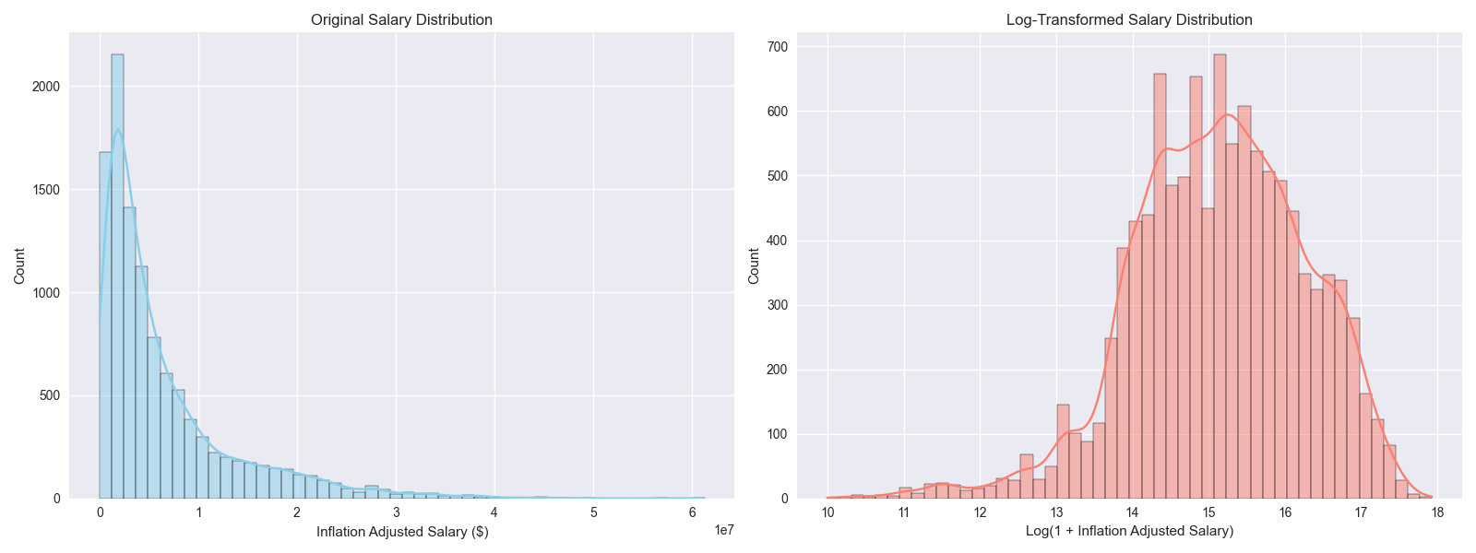
Data Overview
34 player-seasons (rows) contained missing values and were dropped from the dataset
Salary Summary
Min Salary : $21,899
Max Salary: $61,258,556
Med Salary : $3,893,046
Mean Salary: $6,501,424
Std Salary: $7,077,486

Slide 7
Salary Distribution
The left plot shows the real-world distribution of NBA salaries, highlighting the right-skewed nature and the prevalence of lower salaries.
The right plot (log-transformed) reveals the underlying distribution more clearly for modeling purposes.
Log transformation is used in modeling to address skewness and improve regression performance.

Slide 8
Salary Distribution

Slide 9
Feature Engineering
Raw features: All box score stats, shooting percentages, and demographic info.
Created features:
Per-game stats:
Points per Game
Assists per Game
Rebounds per Game, etc.
Per-36-minutes stats:
Points per 36
Rebounds per 36
etc. (normalizes for playing time)
Efficiency ratios:
Assist to Turnover Ratio

Slide 10
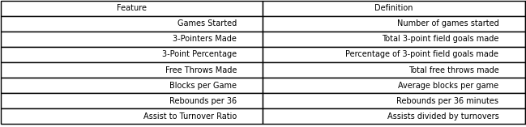
Multicollinearity handling
Used Variance Inflation Factor (VIF) analysis to remove highly correlated features
Final feature set: 7 features selected for modeling

Slide 11
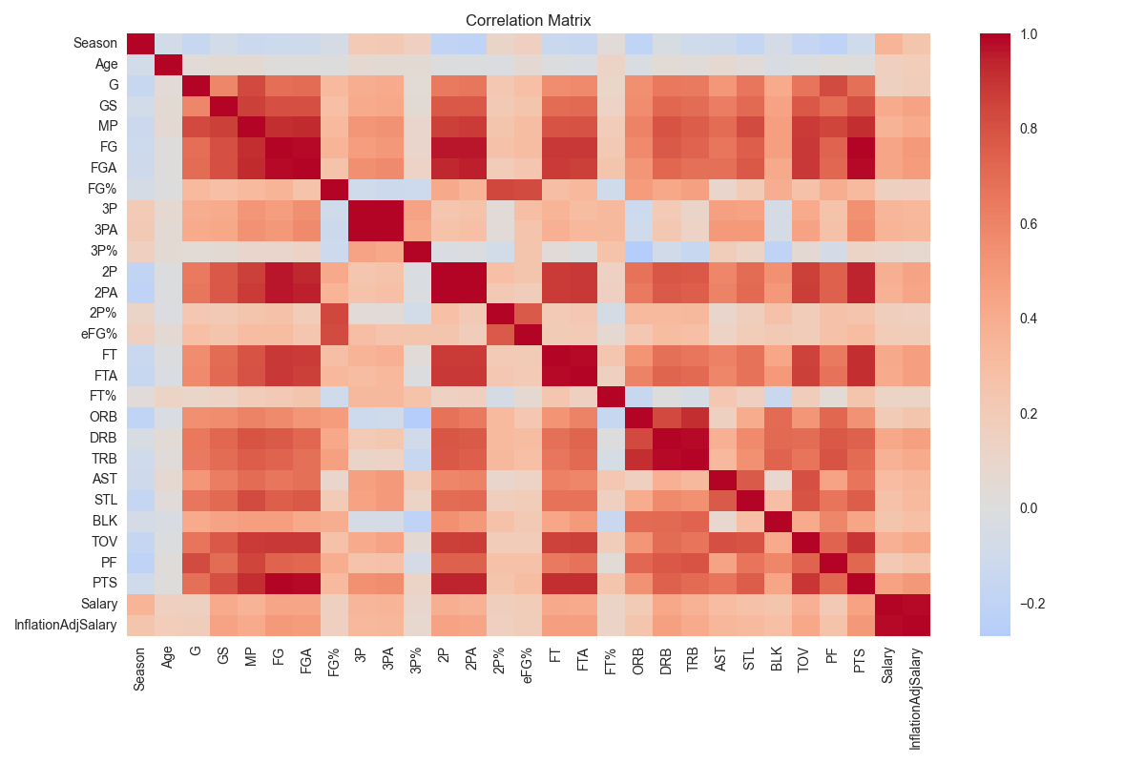
Correlation Analysis
Scoring and playing time are most strongly associated with higher salaries, but efficiency and advanced stats also matter

Slide 12
Data Preprocessing
Outlier handling: 0 salary outliers removed (after inflation adjustment)
Missing values: 34 rows dropped (final: 10,016 rows)
Standardization: All features scaled using StandardScaler
Train/test split: 8,012 training, 2,004 test samples (80/20 split)
Cross-validation is done on the training set

Slide 13
Model Selection & Training
Models evaluated:
Linear Regression
Random Forest Regressor
XGBoost Regressor
Support Vector Regression (SVR)
Cross-validation: 4-fold
Target transformation: log applied to salary to address skewness in response

Slide 14

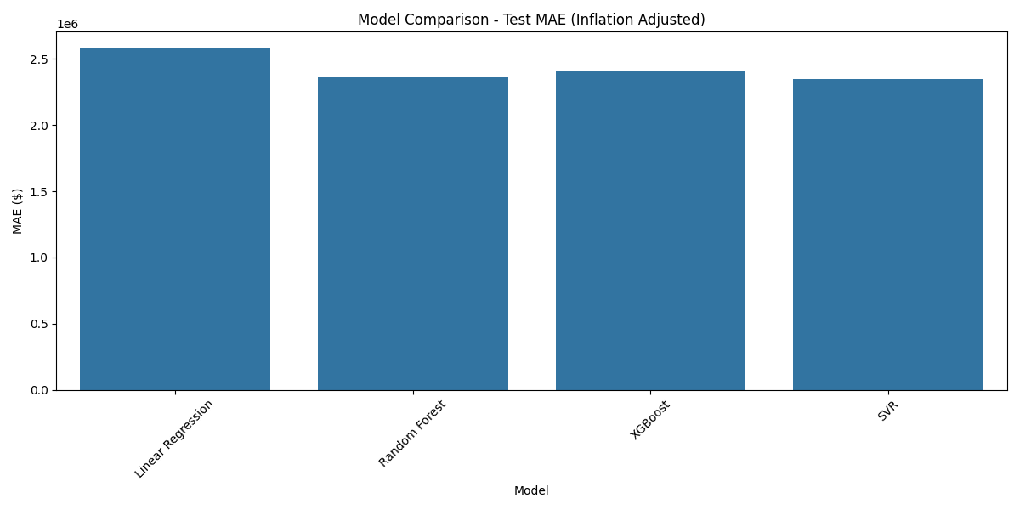
Model Selection & Training

Slide 15

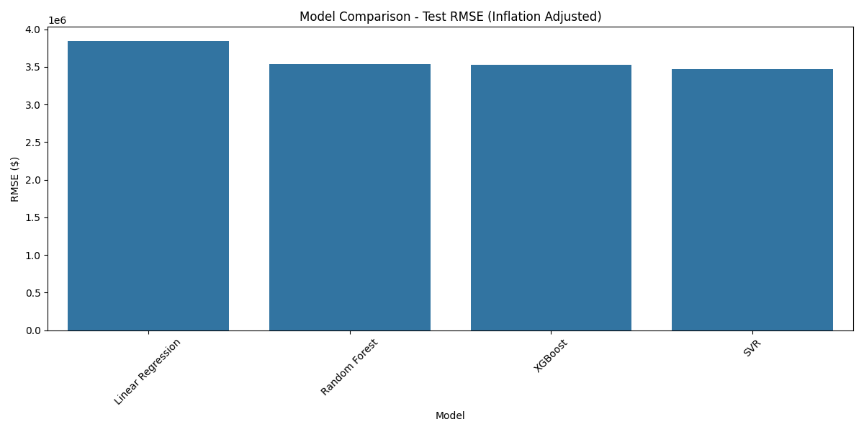
Model Selection & Training

Slide 16
Best Model – SVR
Why SVR?
Effectively captures non-linear relationships between features and salary
Handles outliers well and performs consistently with standardized data
Achieved better performance than tree-based models in this analysis
SVR demonstrated better generalization, particularly for mid-range salaries, outperforming other models in capturing complex patterns.

Slide 17
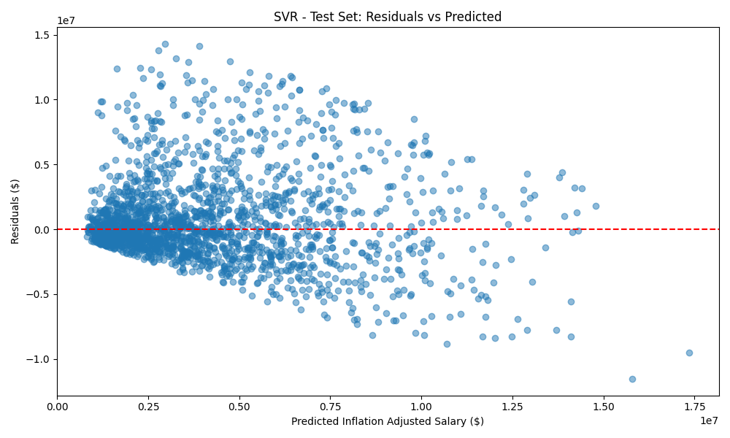
Residual Analysis
Model is accurate for most players, but less so for outliers (superstars)

Slide 18
Conclusion
Overall Performance: SVR accurately predicts most player salaries, effectively capturing non-linear patterns.
Limitations: Less accurate for outliers, especially high-salary superstars.
Recommendation: Avoid using SVR for superstars; consider specialized models for extreme salaries.

